Slide 1

Reflective Teaching Practices
Dr. Rob Danin
English Language Specialist
www.robdanin.com

Slide 2
Reflective Practices
are non-judgmental, collaborative
should allow for flexibility, open-mindedness
To be an effective reflective practitioner, you must recognize that learning from what does not work is on the same path as learning what does work. There must be room for ‘failure’ in the reflective process. (Margaret Keane)
“[Are] more effective when teachers [and students] ...work together” (Echevarria and Graves, 2011)
Learning from others: Reflective practice is enhanced through collaboration and dialogue with colleagues (teachers) and peers (students).
Reflective Practices means…being a life-long learner

Slide 3
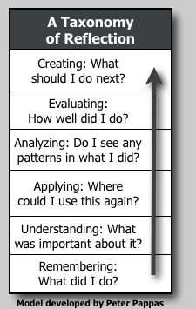
The Reflection Process
Critical Reflection = Critical Thinking
  Reflecting on and making meaning of one’s experiences

Slide 4
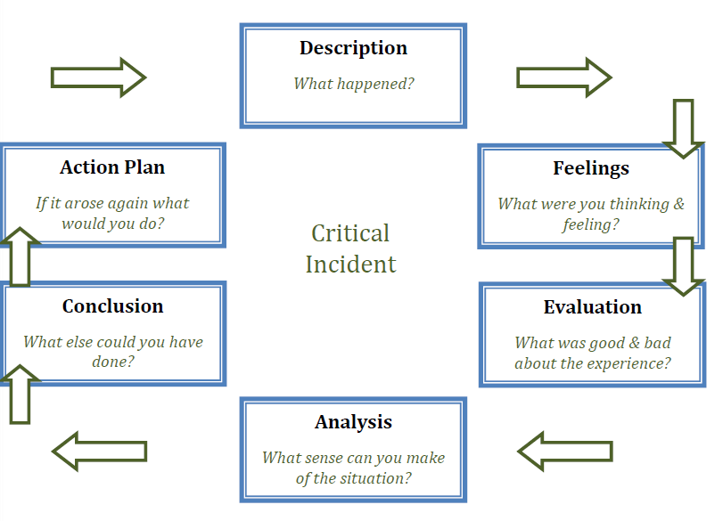
The Reflection Process

Slide 5
Reflective Teaching Considerations
Educational philosophy
Educational research may be applied in the classroom
  Conducting “action research”
How to set up lesson plans
Instructional delivery
  Checking comprehension through guided questions and practice
  Adjusting pace of lesson
Management systems (organizational/behavioral)
Reflecting on the individual needs of the students
Reflecting on pre-service teacher field work
Others:

Slide 6
Questions to consider…
Intended outcomes: What were you trying to do and how did you do it?
What worked? Did not work?
  Celebrate successes
  Learn from mistakes
What did you learn from the experience?
  Positive and negative
  Academic and personal
What are your strengths?
What are your weaknesses?
  Areas to develop
How do you change in order to improve?

Slide 7

Reflective Practice
What is the best experience you ever had in teaching?
Why?
What is the worst?
Why?

Slide 8
Personal Reflective Teaching Tools
Learning Logs (Great for students, too!)
Teaching Logs (Journal sharing)
Teacher Diary: Purely personal reactions and feelings
Collegial observations: Invite a colleague to come into your class to collect information about your lesson
Watching others teach
Student feedback: Simple questionnaires, surveys
Cognitive CoachingSM
  Planning
  Reflecting
  Problem-resolving

Slide 9
Personal Reflective Teaching Tools
Audio or video recordings
Audio recordings
  How much do you talk?
  What about?
  Are instructions and explanations clear?
  How much time do you allocate to student talk?
  How do you respond to student talk?
Video recordings
  Where do you stand?
  Who do you speak to?
  How do you come across to the students?

Slide 10

Reflection Topics for Educators
Was the instructional objective met?
Were the students productively engaged? How do I know?
How do I know students learned what was intended?
Did I alter my instructional plan as I taught the lesson? If so, why?
Do my assessments really reflect learning?
Which students benefited from this activity? Which did not?

Slide 11
Reflection Topics for Educators
What new strategies have I tried lately that might benefit a student I am struggling with?
In what ways am I challenging students who are clearly being successful in my classroom?
What new ideas have I tried in my classroom lately to keep myself energized about teaching?
What can your colleagues do to give you more support?
In what ways can I support my colleagues in their students’ learning?
Others:

Slide 12
Reflection Topics for Students
Reflective journal writing
  What during today’s lesson has frustrated or excited me? What are the next steps in acting on these feelings?
  Having students describe their awareness of their own cross-cultural ethnocentrism or stereotypes.
Personal growth statements
  What have I learned about myself through this educational experience (essay, project, presentation, etc.)?

Slide 13
Reflection Topics for Students
Self-evaluation
  Setting of goals (personal, academic) and determining if and how they were met
  Self-evaluation of performance on projects and papers by providing students a carefully designed rubric
  Student Portfolio: The student participates in the selection of portfolio content, the development of guidelines for selection, and the criteria for judging merit
Peer evaluation: Constructive Feedback
  “A suggestion I can offer for improvement is ________.”
Others:

Slide 14
Student Reflection=Student Motivation http://www.youtube.com/watch?v=LB5s-LKPk4A

Slide 15
As previously discussed…
Educational Philosophy
is a philosophical reflection on the nature, aims, and problems of education. (Encyclopedia of Britannica)
sums up systems of belief for self-reflection and professional growth. (about.com)
As a professional reflective (educational philosophy) activity, please consider your response to the following statements:
What is the purpose of education?
What is your role as an educator?
I believe a good teacher …
The most important thing I try to accomplish is to…
As a teacher, my hope for myself and my students is that…
My plans for the future are to…

Slide 16
Reflective Teaching Resources www.robdanin.com
Thank You!!

