Slide 1
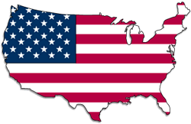
“This Land Is Your Land” https://www.youtube.com/watch?v=wxiMrvDbq3s
Dr. Rob Danin
English Language Specialist
www.robdanin.com

Slide 2
Map of the United States of America

Slide 3
This Land Is Your Land: Vocabulary
California
New York island
redwood forest
Gulf Stream waters
ribbon of highway
endless skyway
golden valley
roamed and rambled
followed my footsteps
sparkling sands
diamond deserts
sun came shining
I was strolling
wheat fields waving
dust clouds rolling
voice was chanting
fog was lifting
"No Trespassing"
“didn't say nothing” (anything)
steeple
freedom highway

Slide 4
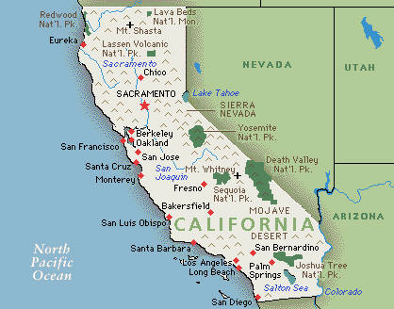
This Land Is Your Land: Sights
California

Slide 5
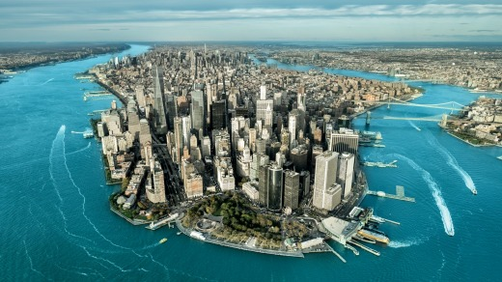
This Land Is Your Land: Sights
New York island

Slide 6
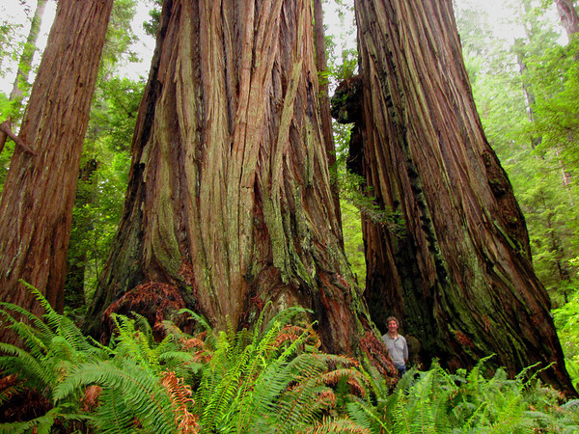
This Land Is Your Land: Sights
red wood forest

Slide 7
Map of the United States of America

Slide 8
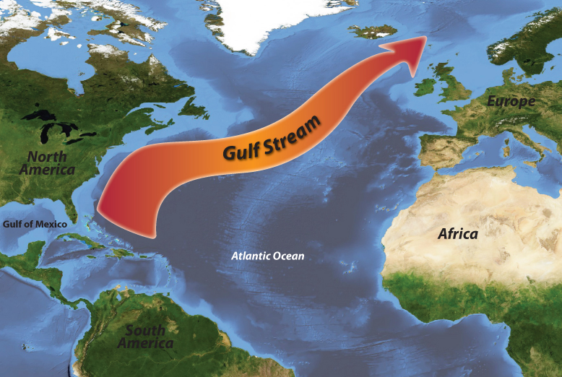
This Land Is Your Land: Sights
Gulf Stream waters

Slide 9
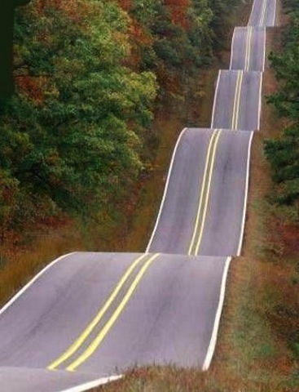
This Land Is Your Land: Sights
ribbon of highway

Slide 10
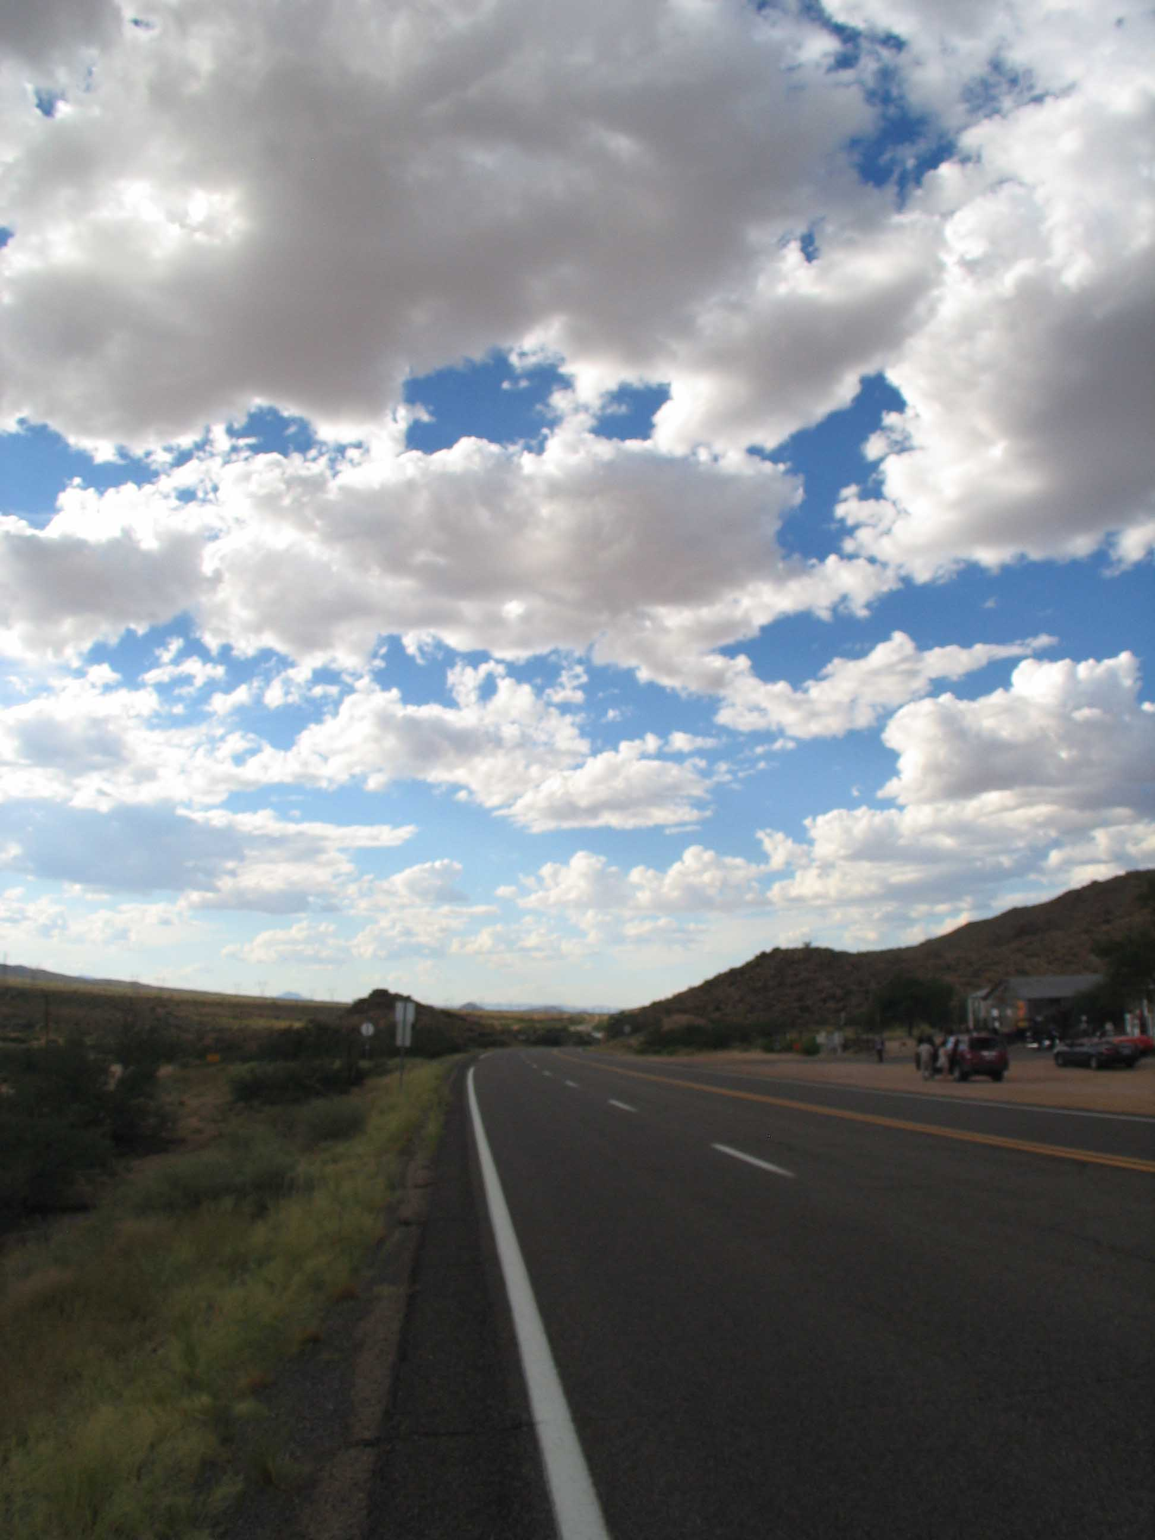
This Land Is Your Land: Sights
endless skyway

Slide 11
Map of the United States of America

Slide 12
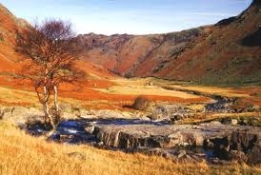
This Land Is Your Land: Sights
golden valley

Slide 13
Map of the United States of America

Slide 14
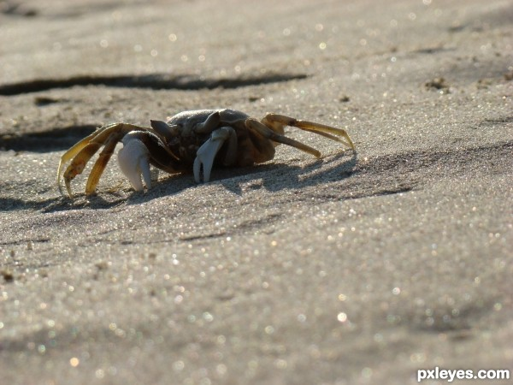
This Land Is Your Land: Sights
sparkling sands

Slide 15
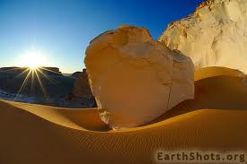
This Land Is Your Land: Sights
diamond deserts

Slide 16
Map of the United States of America

Slide 17
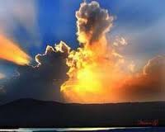
This Land Is Your Land: Sights
sun came shining

Slide 18
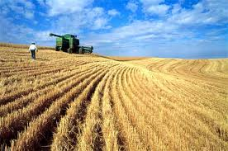
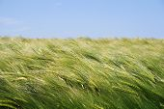
This Land Is Your Land: Sights
wheat fields waving

Slide 19
Map of the United States of America

Slide 20
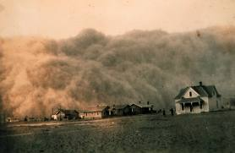
This Land Is Your Land: Sights
dust clouds rolling

Slide 21
Map of the United States of America

Slide 22
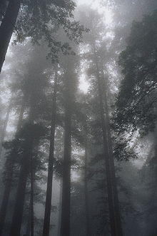
This Land Is Your Land: Sights
fog was lifting

Slide 23
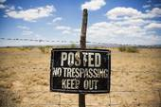
This Land Is Your Land: Sights
"No Trespassing"

Slide 24
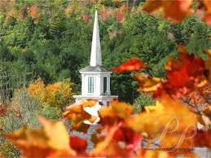
This Land Is Your Land: Sights
steeple

Slide 25
Map of the United States of America

Slide 26
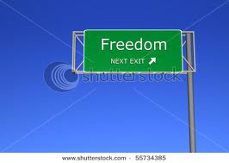
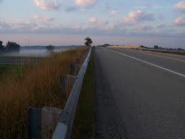
This Land Is Your Land: Sights
freedom highway

Slide 27
This Land Is Your Land: Grapes of Wrath
The Grapes of Wrath is an American novel written by John Steinbeck, published in 1939. Set during the Great Depression, the novel focuses on the Joads, a poor family of tenet farmers driven from their Oklahoma home by drought and economic hardship. They were trapped in the Dust Bowl, so the Joads set out for California. Along with thousands of other “Okies” , they sought jobs, land, dignity, and a future. (Wikipedia)

Slide 28
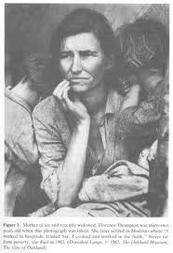
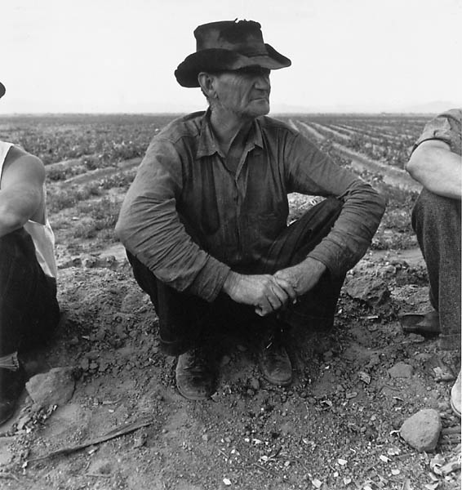
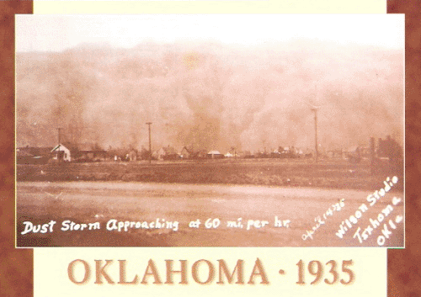
This Land Is Your Land: Oklahoma

Slide 29
Map of the United States of America

Slide 30
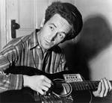
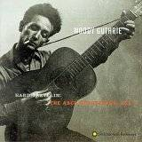
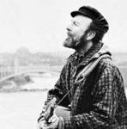
This Land Is Your Land: Folk (Protest) Singers
Woody Guthrie (1912-1967),
Years active 1930–1956
Pete Seeger

Slide 31
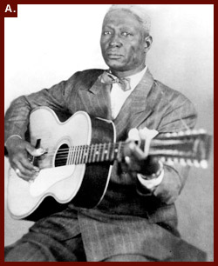
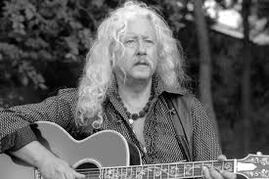
This Land Is Your Land: Folk (Protest) Singers
Lead Belly (Ledbetter)
Arlo Guthrie

Slide 32
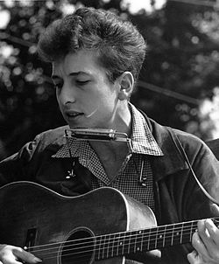
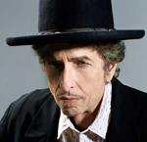
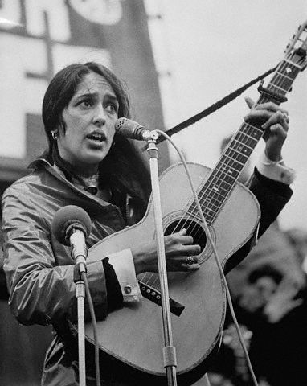
This Land Is Your Land: Folk (Protest) Singers
Bob Dylan
Joan Baez

Slide 33
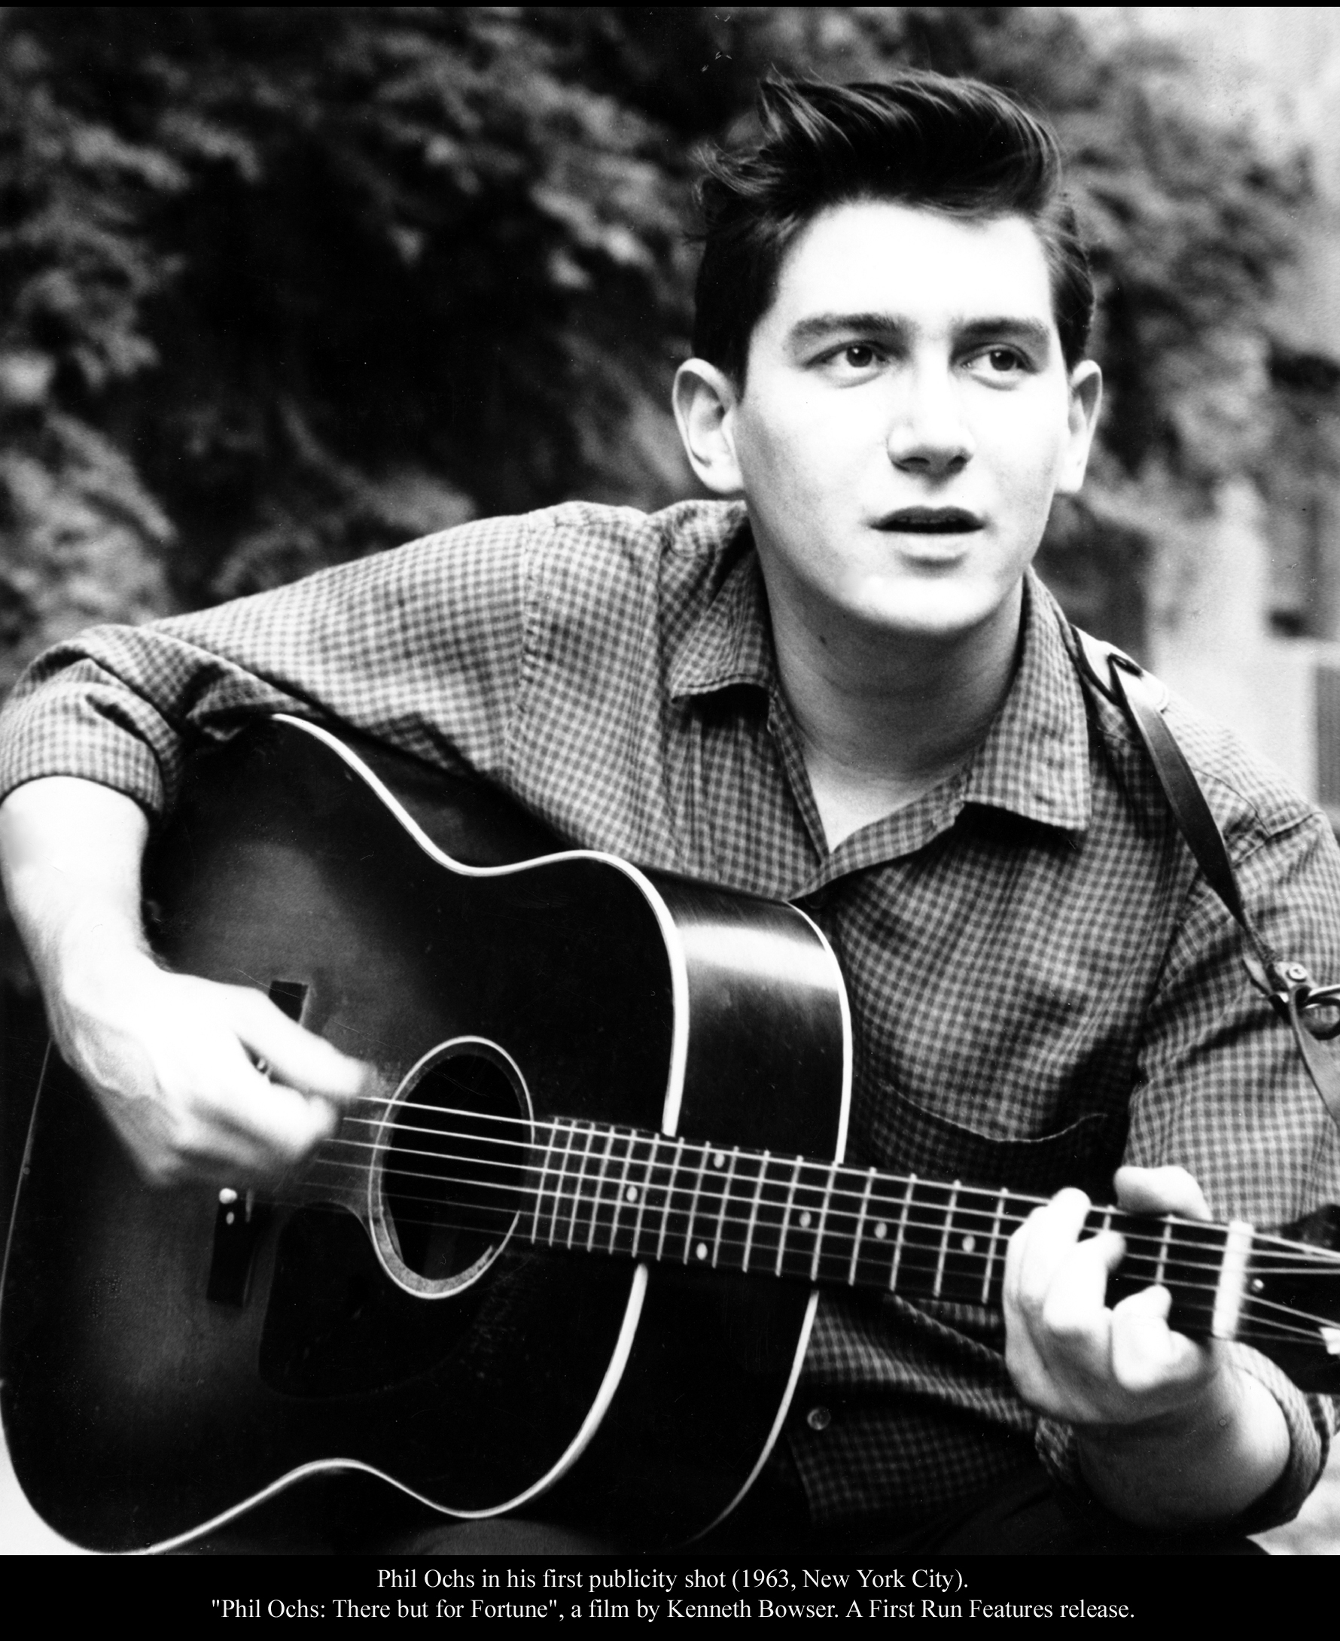
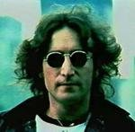
This Land Is Your Land: Folk (Protest) Singers
Phil Ochs
John Lennon

Slide 34
This Land Is Your Land: Journey’s End
https://www.youtube.com/watch?feature=player_embedded&v=XaI5IRuS2aE

